Slide 1
Goals and Objectives of Social Work
Dr. Imran A. Sajid,
Lecturer (Social Work),
University of Peshawar
imranahmad131@uop.edu.pk

Slide 2
Dictionary meaning of Goal and Objective
Dictionary meaning of goal is “target area”, or
“the desired results an individual or organization plans and commits to achieve”.
In Urdu, the word goal is translated asمقصود، منزل مقصود، مطمع نظر، نصب العین
Objectives: dictionary meaning of “A specific result that a person or system aims to achieve within a timeframe.”

Slide 3
Goal of Social Work
* the degree of enjoyment and satisfaction experienced in everyday life as opposed to financial or material well-being
“promote[ing] or restore[ing] a mutually beneficial interaction between individuals and society in order to improve the quality of life* for every one.

Slide 4
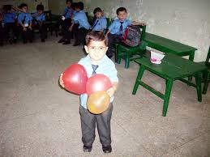
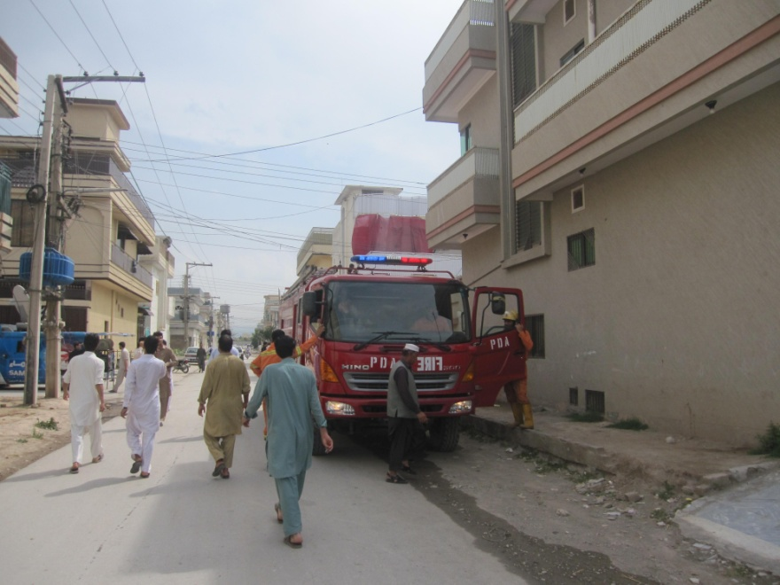
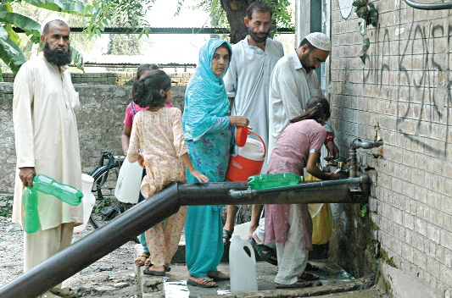

Slide 5
Objectives / Functions of Social Work
Social Work practice has at least four major objectives, namely
Empowering people →or Enhance the people’s capacities to resolve problem, cope, and function effectively;
Linking clients with systems/needed resources
Improve the social services delivery network
Promote Social Justice through the development of social policy

